Slide 1
CLL122 project

Slide 2

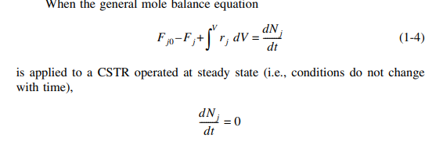
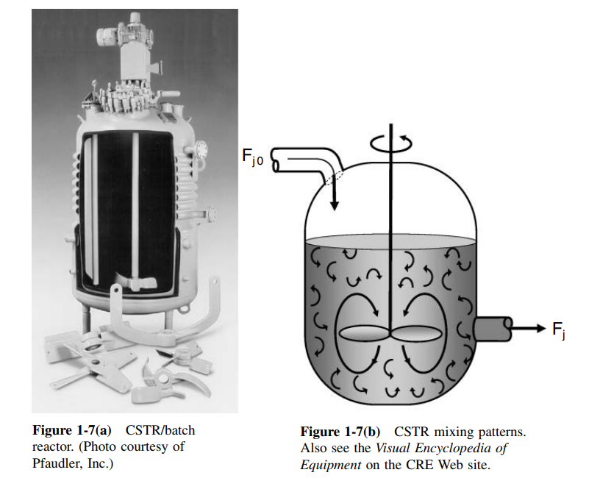

Continuous-Stirred Tank Reactor(CSTR)

Slide 3
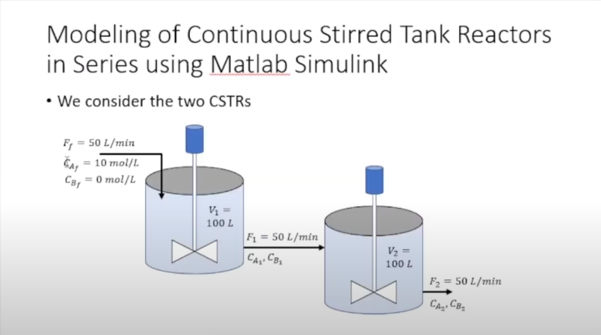

Slide 4
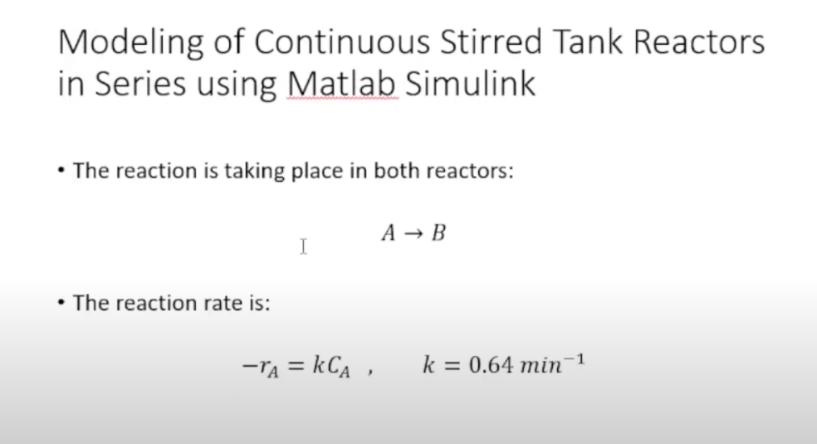

Slide 5


Slide 7
